Slide 1
Self Balancing Robot
Control Systems – CIE 318
June
2022

Slide 2
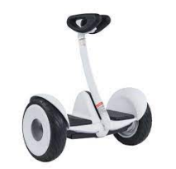
Introduction and Background
A self balancing robot is like a car with two wheels that balances itself by continuously measuring the angle between the robot’s normal axis and the robot normal axis and vertical axis and in case of slight deviation the robot starts moving in the reverse direction to balance itself.
It’s used in various applications such as Segway shown in the figure that is used in short trips as to supermarket

Slide 3
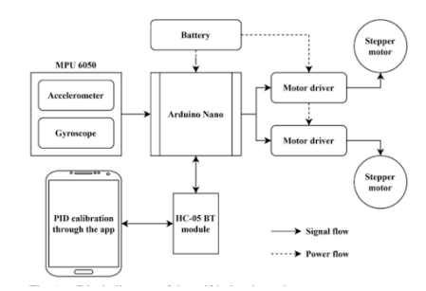
Literature Review
In Shekhawat Paper, They used a stepper motor (they justified it’s more accurate to improve stability) and MPU 6050 sensor to calculate the acceleration and angle. Then they used the two parameters to control the behavior of the system. And they used a PID Controller with a Bluetooth module for communication between the system and mobile application.

Slide 4
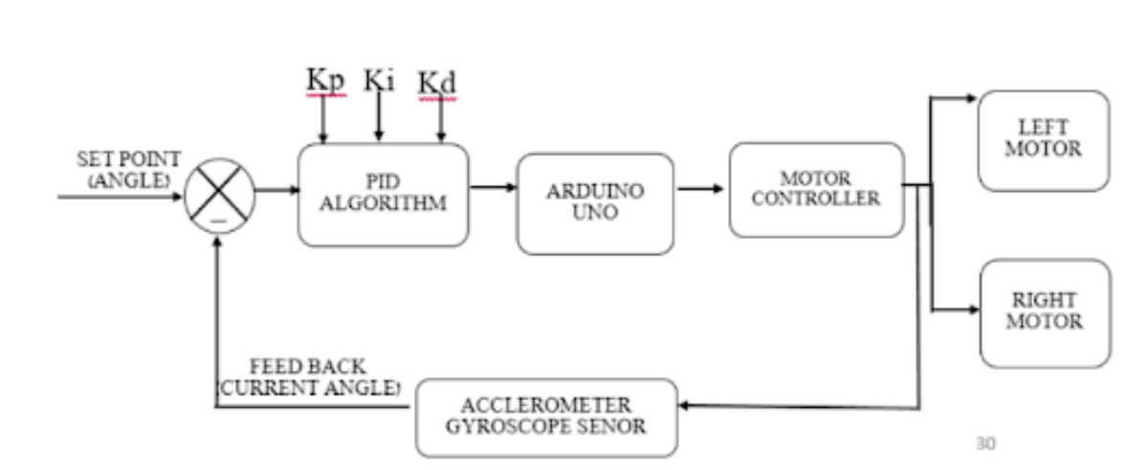
Literature Review
Professor Baskaran and his student Raja provided us with some modifications in specific parts of the robot. They modeled the robot as an inverted pendulum and they stated that the main goal of the project is to maintain the center of the robot under the wheels , consequently if the robot tilted forwarded, the wheels should move forward to maintain the condition; otherwise, it would fall down. The paper starts by assuming that the robot moves only in one direction, they did that as it would simplify their calculations a lot.

Slide 5
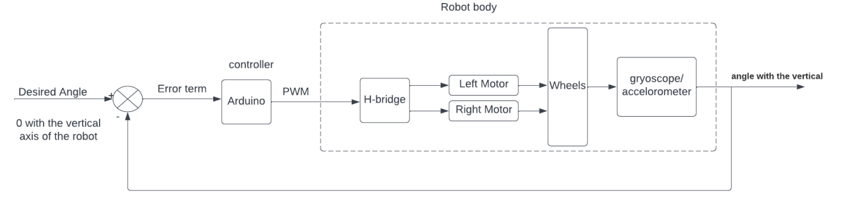
Functional Block diagram
We pass the error term (the desired angle which is 0 – the actual angle) to the PID controller implemented using Arduino UNO. The output of the Arduino UNO is the PWM signal passed to the H-Bridge to control the left and right motor that give the power to both wheels. We then measure the angle between the normal position and the vertical position using MPU 6050 sensor, and pass this angle as a feedback to the controller again.

Slide 6
List of components
Component | Quantity
Arduino UNO | x1
Batteries | x4
DC Motor | x2
MPU 6050 | x1
Acrylic Plastic Sheets | x2
Dual H-Bridge L298N | x1

Slide 7
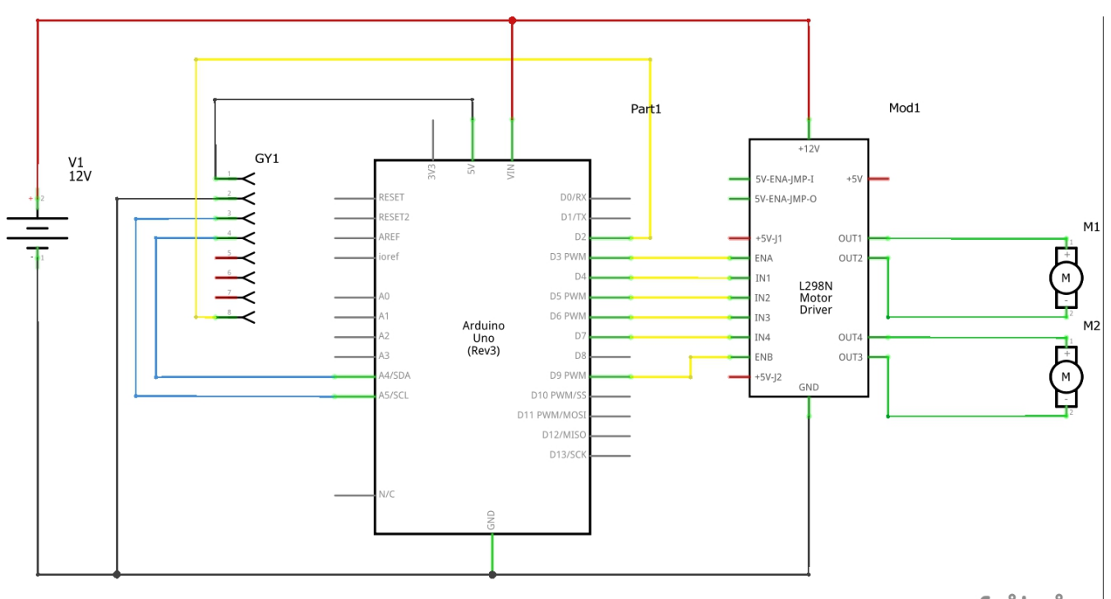
Schematic diagram
1- Arduino UNO: Our Microcontroller in the project that needs 6-12V to be powered. 2- DC Motor: We used 2 motors, one for each wheel. 3- L298N: Our motor Driver, we only used one as one driver can power two motors. 4- MPU 6050: Our sensor that gives the feedback to the controller to perform the required function.
5- Batteries: 12V Batteries to power the Arduino and the Motor drivers.

Slide 8
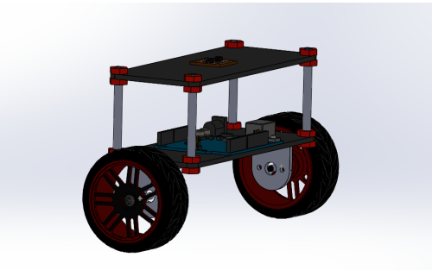
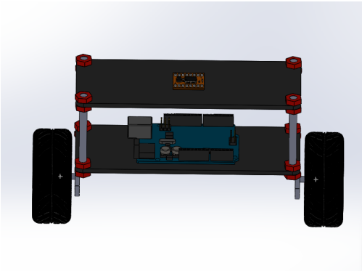
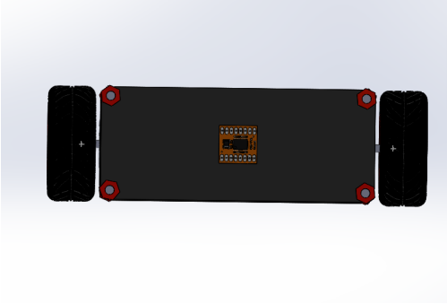
CAD design

Slide 9
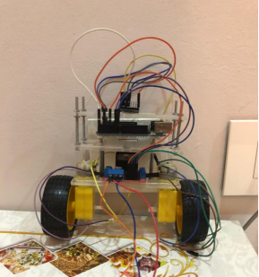
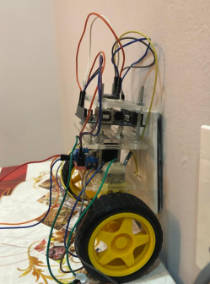
Full Hardware Design

Slide 10
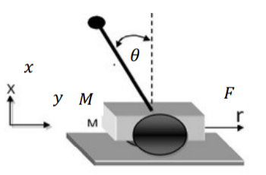
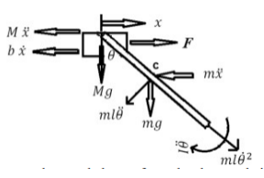
Mathematical Model
The system is modeled as an inverted pendulum as mentioned before Figure 1 represents the model for an inverted pendulum where θ is inclined angle, F is force given to the model, M denotes model mass, y and x are axis of vertical and horizontal, respectively. In our project, We will use DC motors to provide the appropriate velocity, so the robot remains balance. Without the appropriate velocity, the robot will be fallen.
Variable | Description | Value
M | Mass of the cart | 0.0345533kg
m | Mass of pendulum rod | 0.2127567kg
B | Viscous friction coefficient | 0.1/m/sec
L | One half pendulum rod Length | 0.04575 m
I | Inertia moment robot

Slide 11




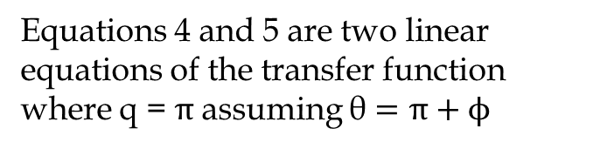
Mathematical Model
After plugging in those 3 equations we obtained two variations of motion equations. The U value represents the input.
Applying Laplace transform to the two equations above:

Slide 12
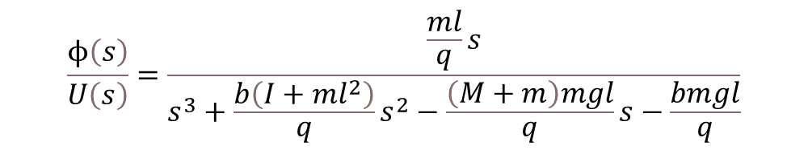

Mathematical Model
From the previous two equations, we get the transfer function of the system as:
Where Q is:
Plugging in the values from the table we get the transfer function as:

Slide 13
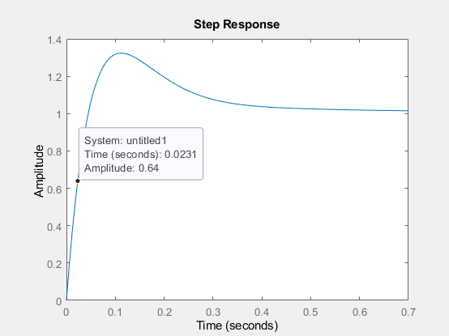
tIME CONSTANT CALCULATION
There was a need to calculate the value of Time constant to be able to calculate the sampling time,
Time constant = 0.0231 sec.
Choosing Ts = 0.001 sec.

Slide 14
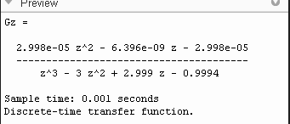
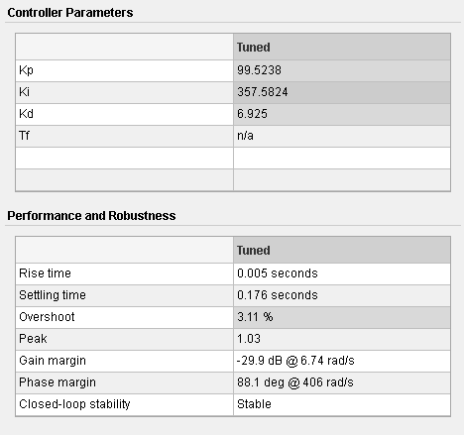
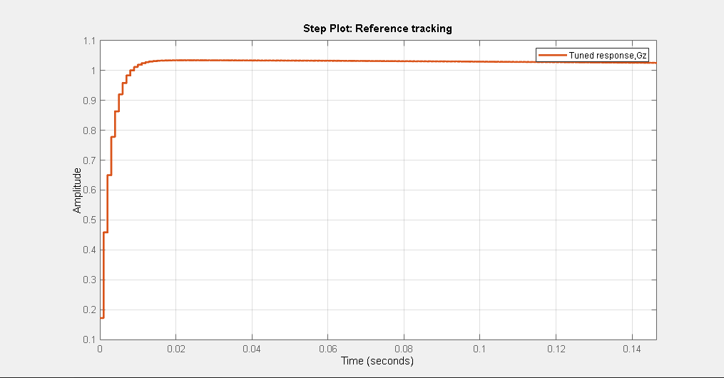
System Analysis
Using MATLAB to convert the transfer function to Z-domain:

Slide 15
Thank You!

